Slide 1
Building a Neural Network from scratch in R
Owen Jones ∙ Bath Machine Learning Meetup ∙ 1st March 2017

Slide 2
What is the most important network we’ll be using tonight?

Slide 3
Building a Social Network from scratch in BMLM
Owen Jones ∙ Bath Machine Learning Meetup ∙ 1st March 2017

Slide 4
What’s a neural network?

Slide 5
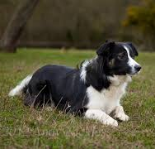
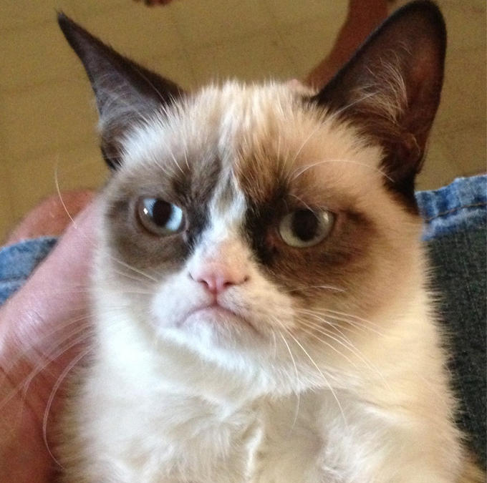
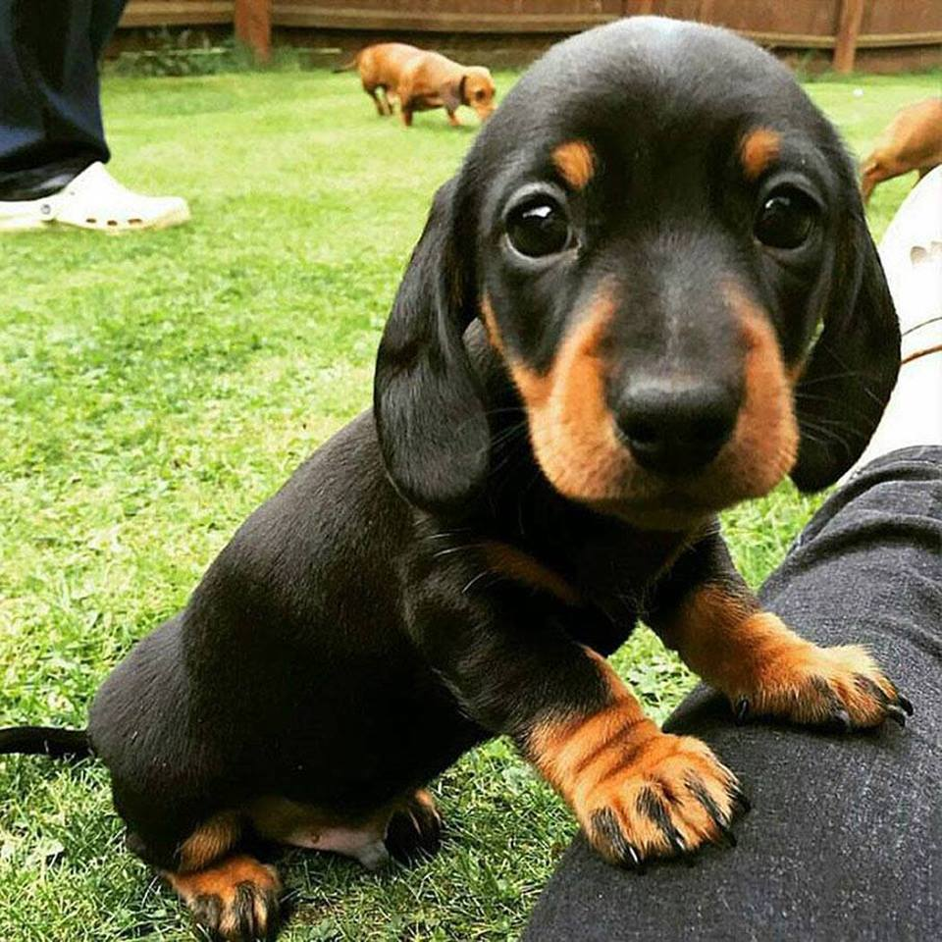
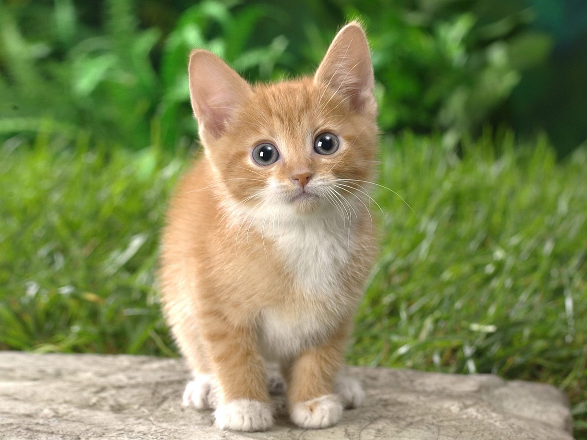
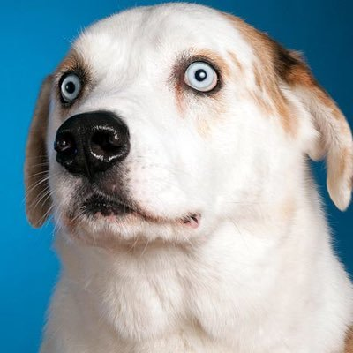
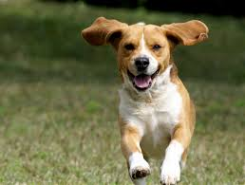
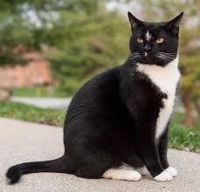
What’s a neural network?
OK.
This is a dog
This is a cat
This is a dog
This is a cat
This is a dog
This is a dog
This is a cat

Slide 6

What’s a neural network?
Dog!
What is this?

Slide 7
Data
Kaggle competition page
https://kaggle.com/c/digit-recognizer
Data
https://kaggle.com/c/digit-recognizer/data

Slide 8
What are these numbers?

Slide 9
What are these numbers?
0
60
140
200
255
0
60
140
200
255
0
60
140
200
255
0
60
140
200
255
0
60
140
200
255

Slide 10
What are these numbers?
0
60
140
200
255
0
60
140
200
255
0
60
140
200
255
0
60
140
200
255
0
60
140
200
255

Slide 11
What are these numbers?
0
60
140
200
255
0
60
140
200
255
0
60
140
200
255
0
60
140
200
255
0
60
140
200
255

Slide 12
Why relabel 0?
Zero-indexed
0 | 1 | 2 | 3 | 4 | 5 | 6 | 7 | 8 | 9
1st
2nd
3rd
One-indexed
1 | 2 | 3 | 4 | 5 | 6 | 7 | 8 | 9 | 10

Slide 13
Why relabel 0?
Zero-indexed
0 | 1 | 2 | 3 | 4 | 5 | 6 | 7 | 8 | 9
1st
2nd
3rd
One-indexed
1 | 2 | 3 | 4 | 5 | 6 | 7 | 8 | 9 | 10

Slide 14
Why relabel 0?
Zero-indexed
0 | 1 | 2 | 3 | 4 | 5 | 6 | 7 | 8 | 9
1st
2nd
3rd
One-indexed
1 | 2 | 3 | 4 | 5 | 6 | 7 | 8 | 9 | 10
3
0 | 0 | 1 | 0 | 0 | 0 | 0 | 0 | 0 | 0

Slide 15
Making sets
Everything!
100%

Slide 16
Making sets
Training set
60%
Cross-validation set
20%
Test set
20%

Slide 17



How does the net make predictions?

Slide 18
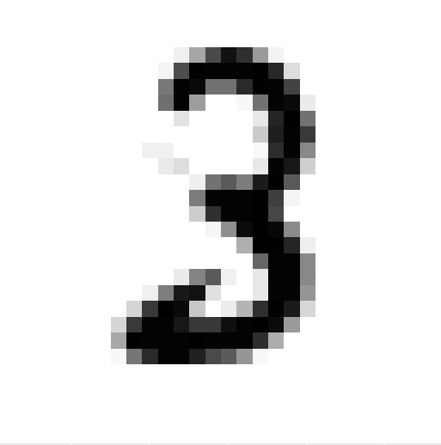
How does the net make predictions?

Slide 19
How does the net make predictions?

Slide 20
How does the net make predictions?

Slide 21
How does the net make predictions?
Sum = 1000
Sum = 300
Sum = 800

Slide 22
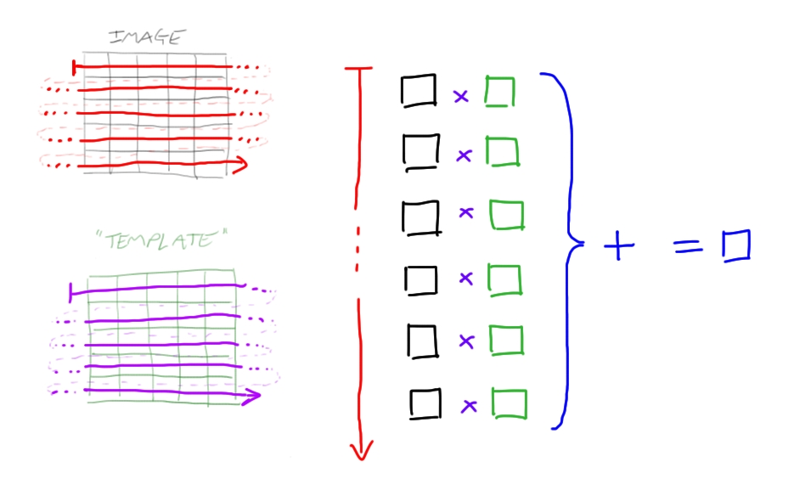
Network structure

Slide 23
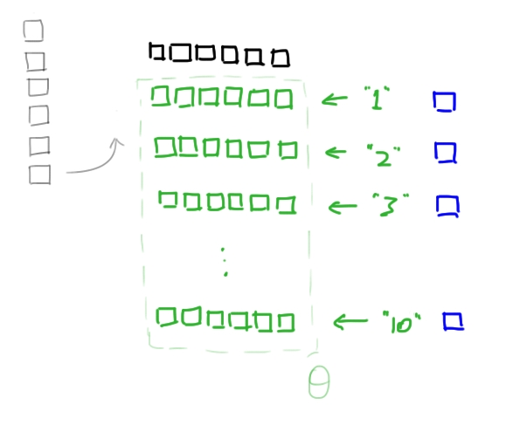
Network structure

Slide 24
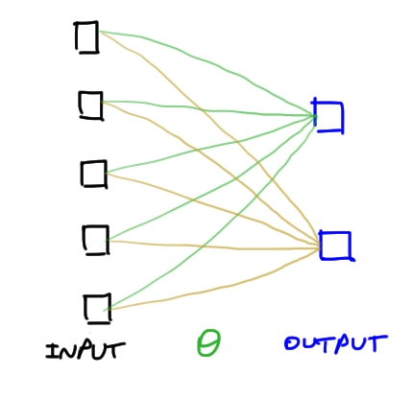
Network structure

Slide 25
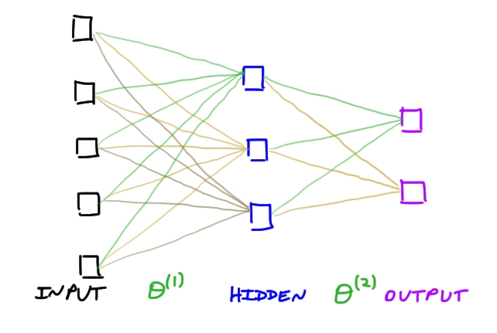
Network structure

Slide 26
Matrices

Slide 27
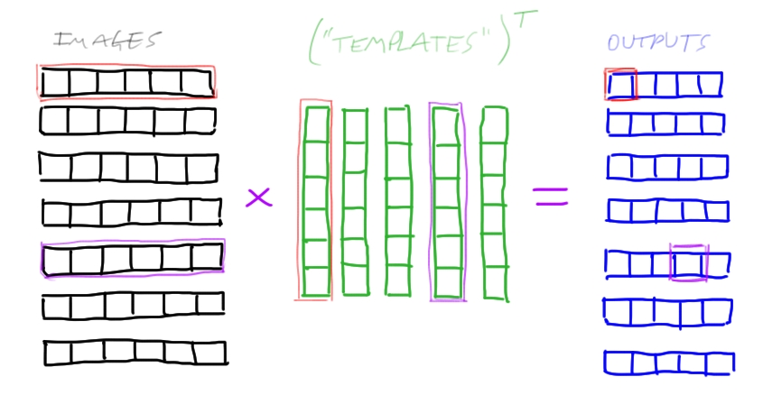
Matrices

Slide 28
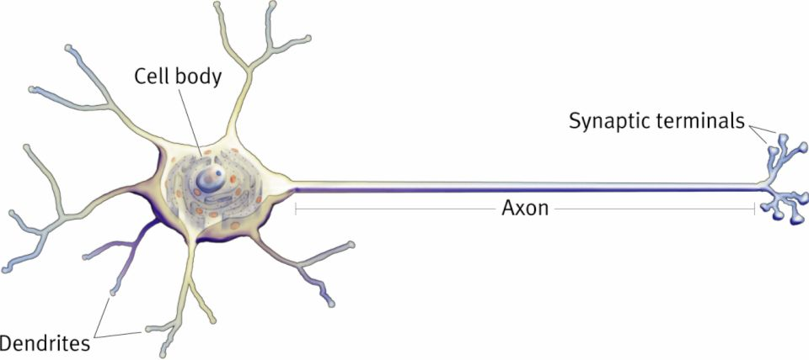
Biological neuron

Slide 29
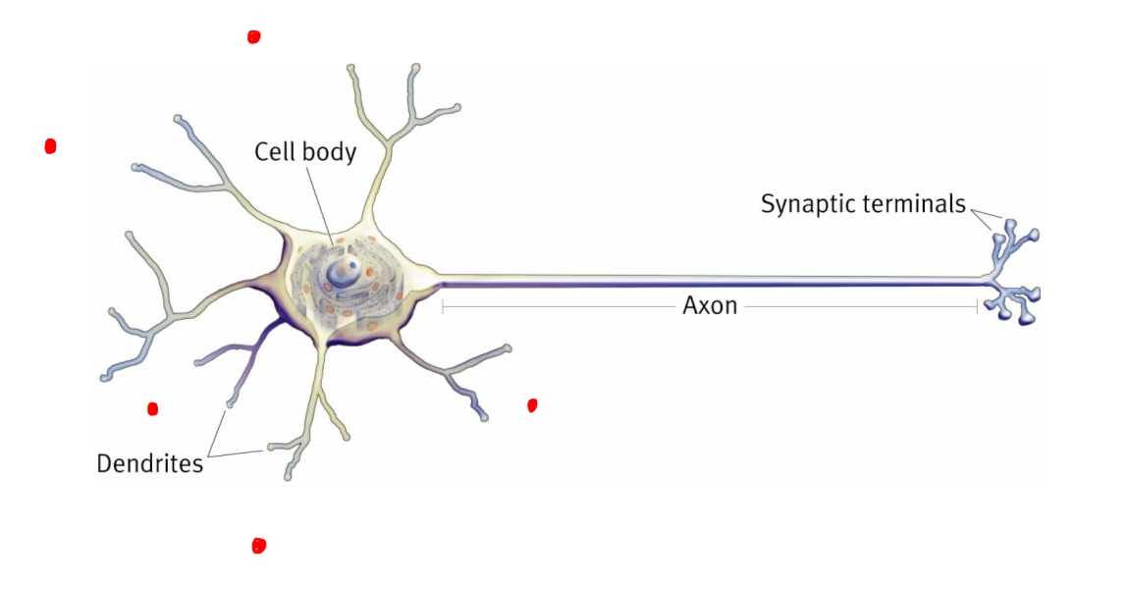
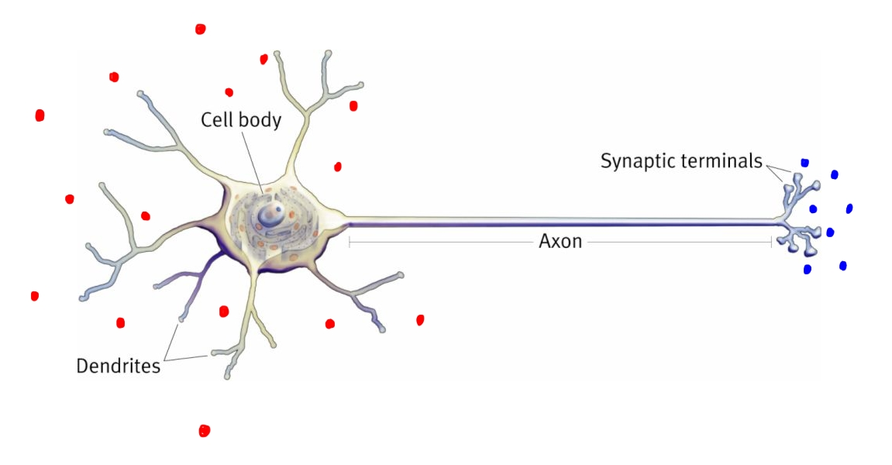
Biological neuron

Slide 30
Biological neuron

Slide 31
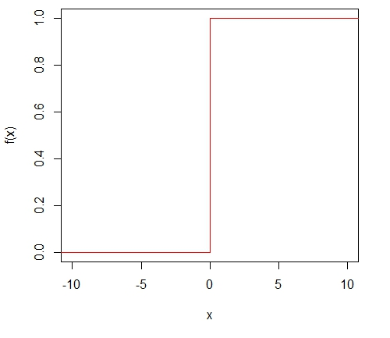
Activation functions

Slide 32
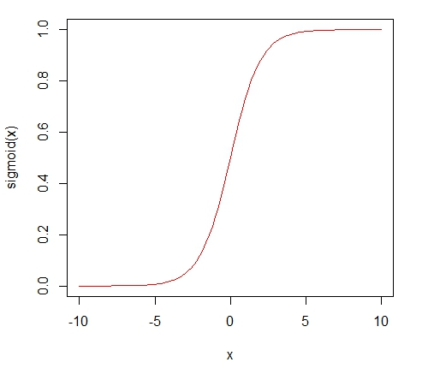
Activation functions

Slide 33
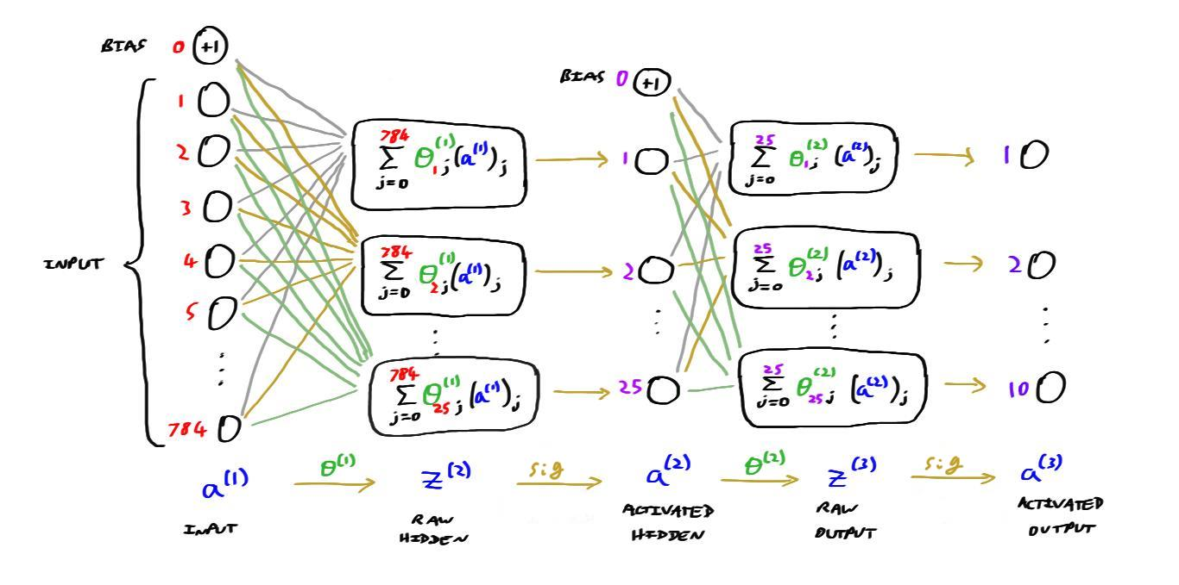
Network structure

Slide 34
How wrong were we?
Prediction (A3)
0.08 | 0.31 | 0.85 | 0.37 | 0.43 | 0.51 | 0.12 | 0.54 | 0.71 | 0.42
Actual
0 | 0 | 0 | 0 | 0 | 0 | 0 | 0 | 1 | 0
-log(A3) * Actual
0 | 0 | 0 | 0 | 0 | 0 | 0 | 0 | 0.34 | 0

Slide 35
How wrong were we?
Prediction (A3)
0.08 | 0.31 | 0.85 | 0.37 | 0.43 | 0.51 | 0.12 | 0.54 | 0.71 | 0.42
Actual
0 | 0 | 0 | 0 | 0 | 0 | 0 | 0 | 1 | 0
-log(A3) * Actual
0 | 0 | 0 | 0 | 0 | 0 | 0 | 0 | 0.34 | 0
1 - A3
0.92 | 0.69 | 0.15 | 0.63 | 0.57 | 0.49 | 0.88 | 0.46 | 0.29 | 0.58
1 - Actual
1 | 1 | 1 | 1 | 1 | 1 | 1 | 1 | 0 | 1
-log(1 - A3) * (1 - Actual)
0.08 | 0.37 | 1.90 | 0.46 | 0.56 | 0.71 | 0.13 | 0.78 | 0 | 0.54

Slide 36
How wrong were we?
Prediction (A3)
0.08 | 0.31 | 0.85 | 0.37 | 0.43 | 0.51 | 0.12 | 0.54 | 0.71 | 0.42
Actual
0 | 0 | 0 | 0 | 0 | 0 | 0 | 0 | 1 | 0
-log(A3) * Actual
0 | 0 | 0 | 0 | 0 | 0 | 0 | 0 | 0.34 | 0
1 - A3
0.92 | 0.69 | 0.15 | 0.63 | 0.57 | 0.49 | 0.88 | 0.46 | 0.29 | 0.58
1 - Actual
1 | 1 | 1 | 1 | 1 | 1 | 1 | 1 | 0 | 1
-log(1 - A3) * (1 - Actual)
0.08 | 0.37 | 1.90 | 0.46 | 0.56 | 0.71 | 0.13 | 0.78 | 0 | 0.54
Cost (J) = 0.34 + 0.08 + 0.37 + 1.90 + 0.46 + 0.56 + 0.71 + 0.13 + 0.78 + 0.54 = 5.87

Slide 37
Multilayer perceptron

Slide 38
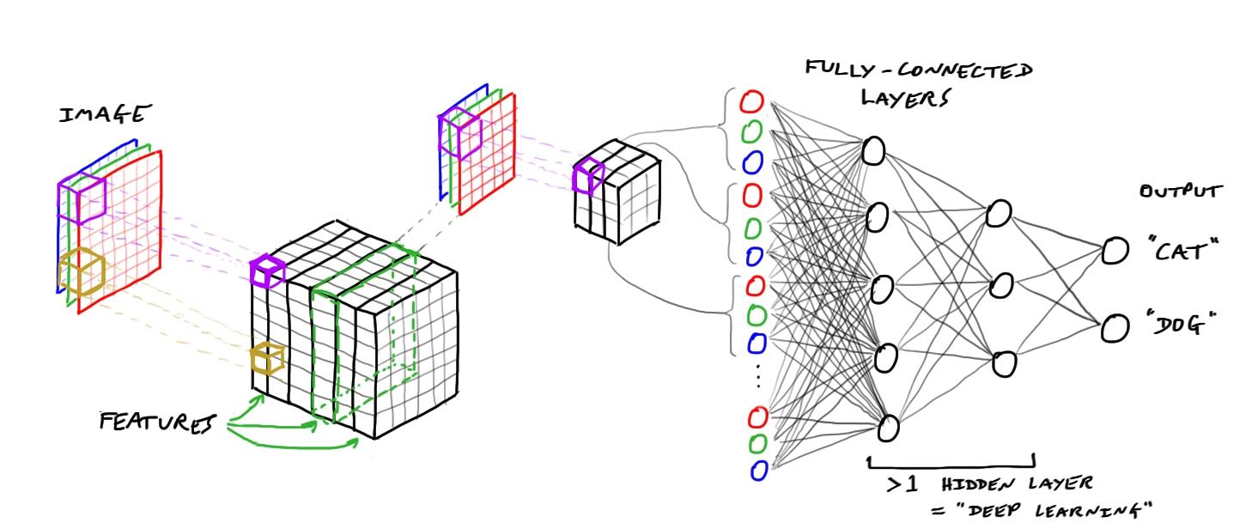
Convolutional neural networks

Slide 39
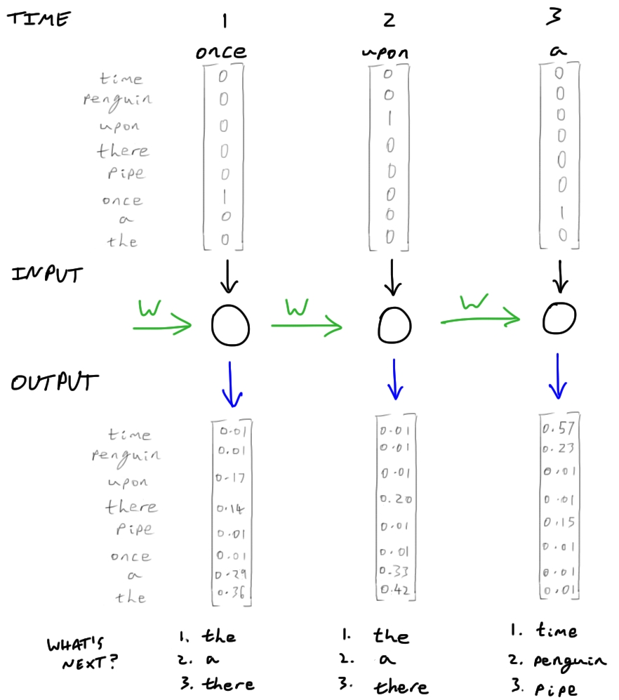
Recurrent neural networks

Slide 40
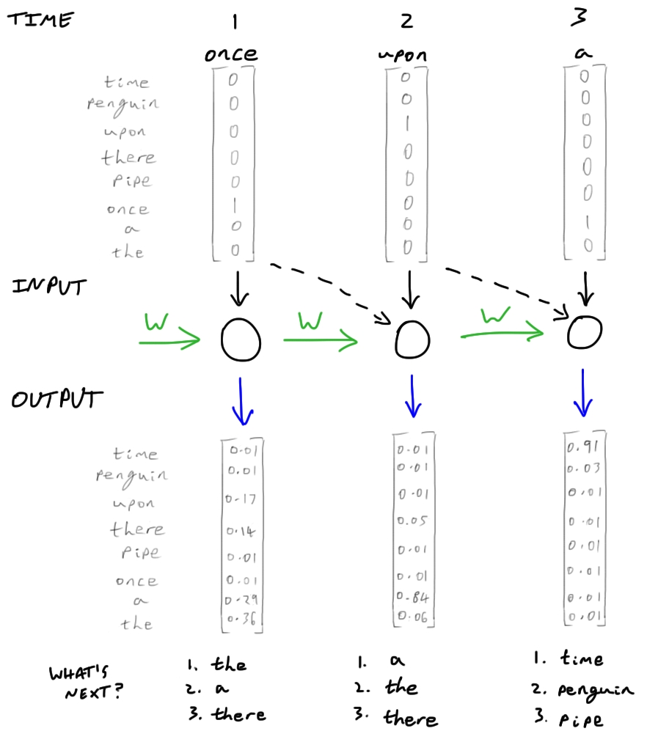
Recurrent neural networks

Slide 41
Learning from experience
OK.
This is a dog
This is a cat
This is a dog
This is a cat
This is a dog
This is a dog
This is a cat

Slide 42
Learning from experience
Dog!
What is this?

Slide 43
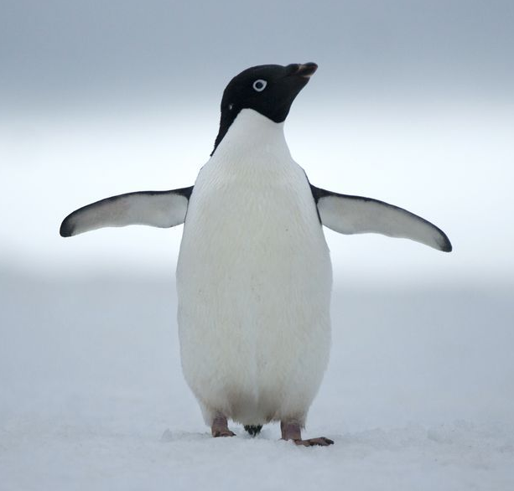
Learning from experience
Cat!
What is this?

Slide 44
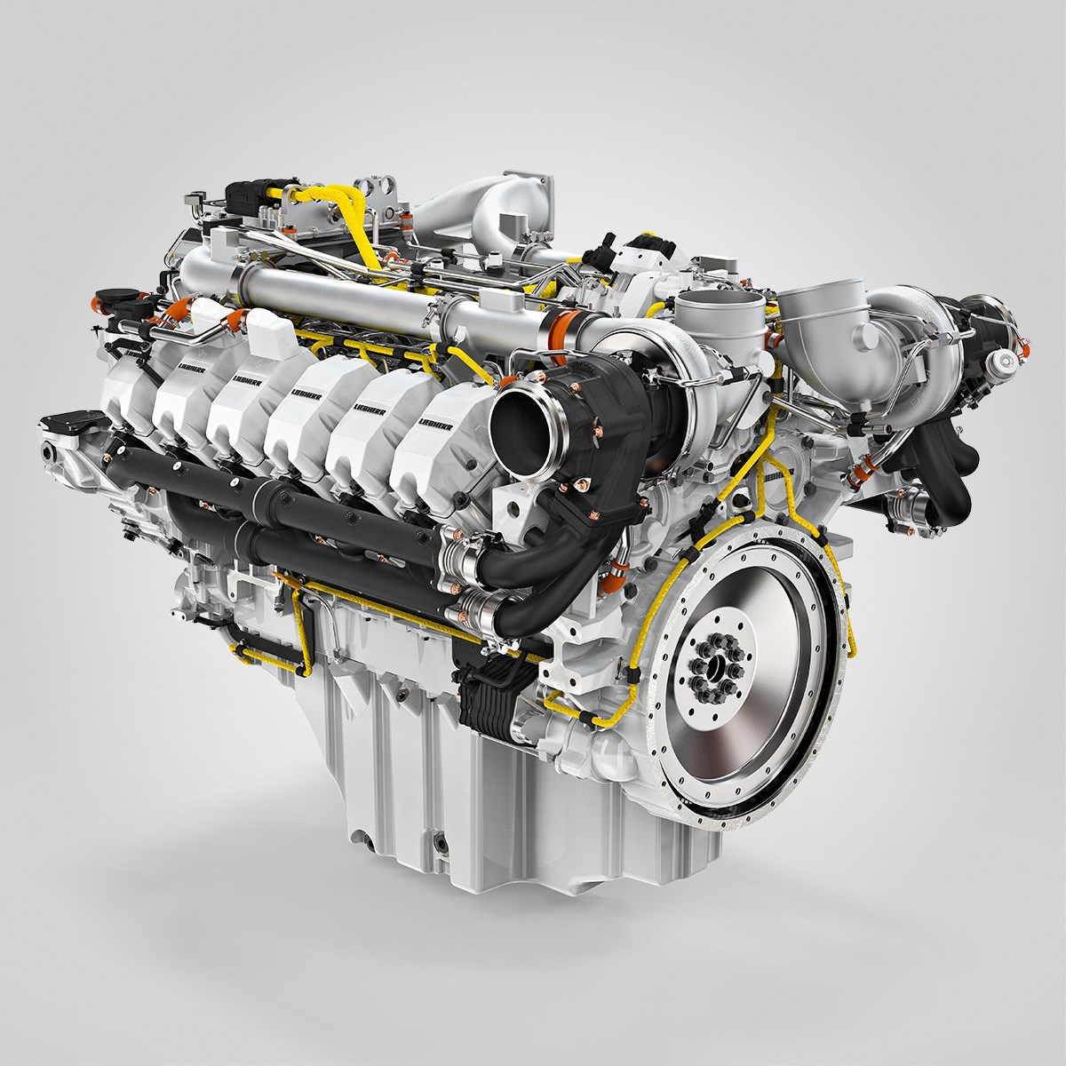
Learning from experience
Dog?
What is this?

Slide 45
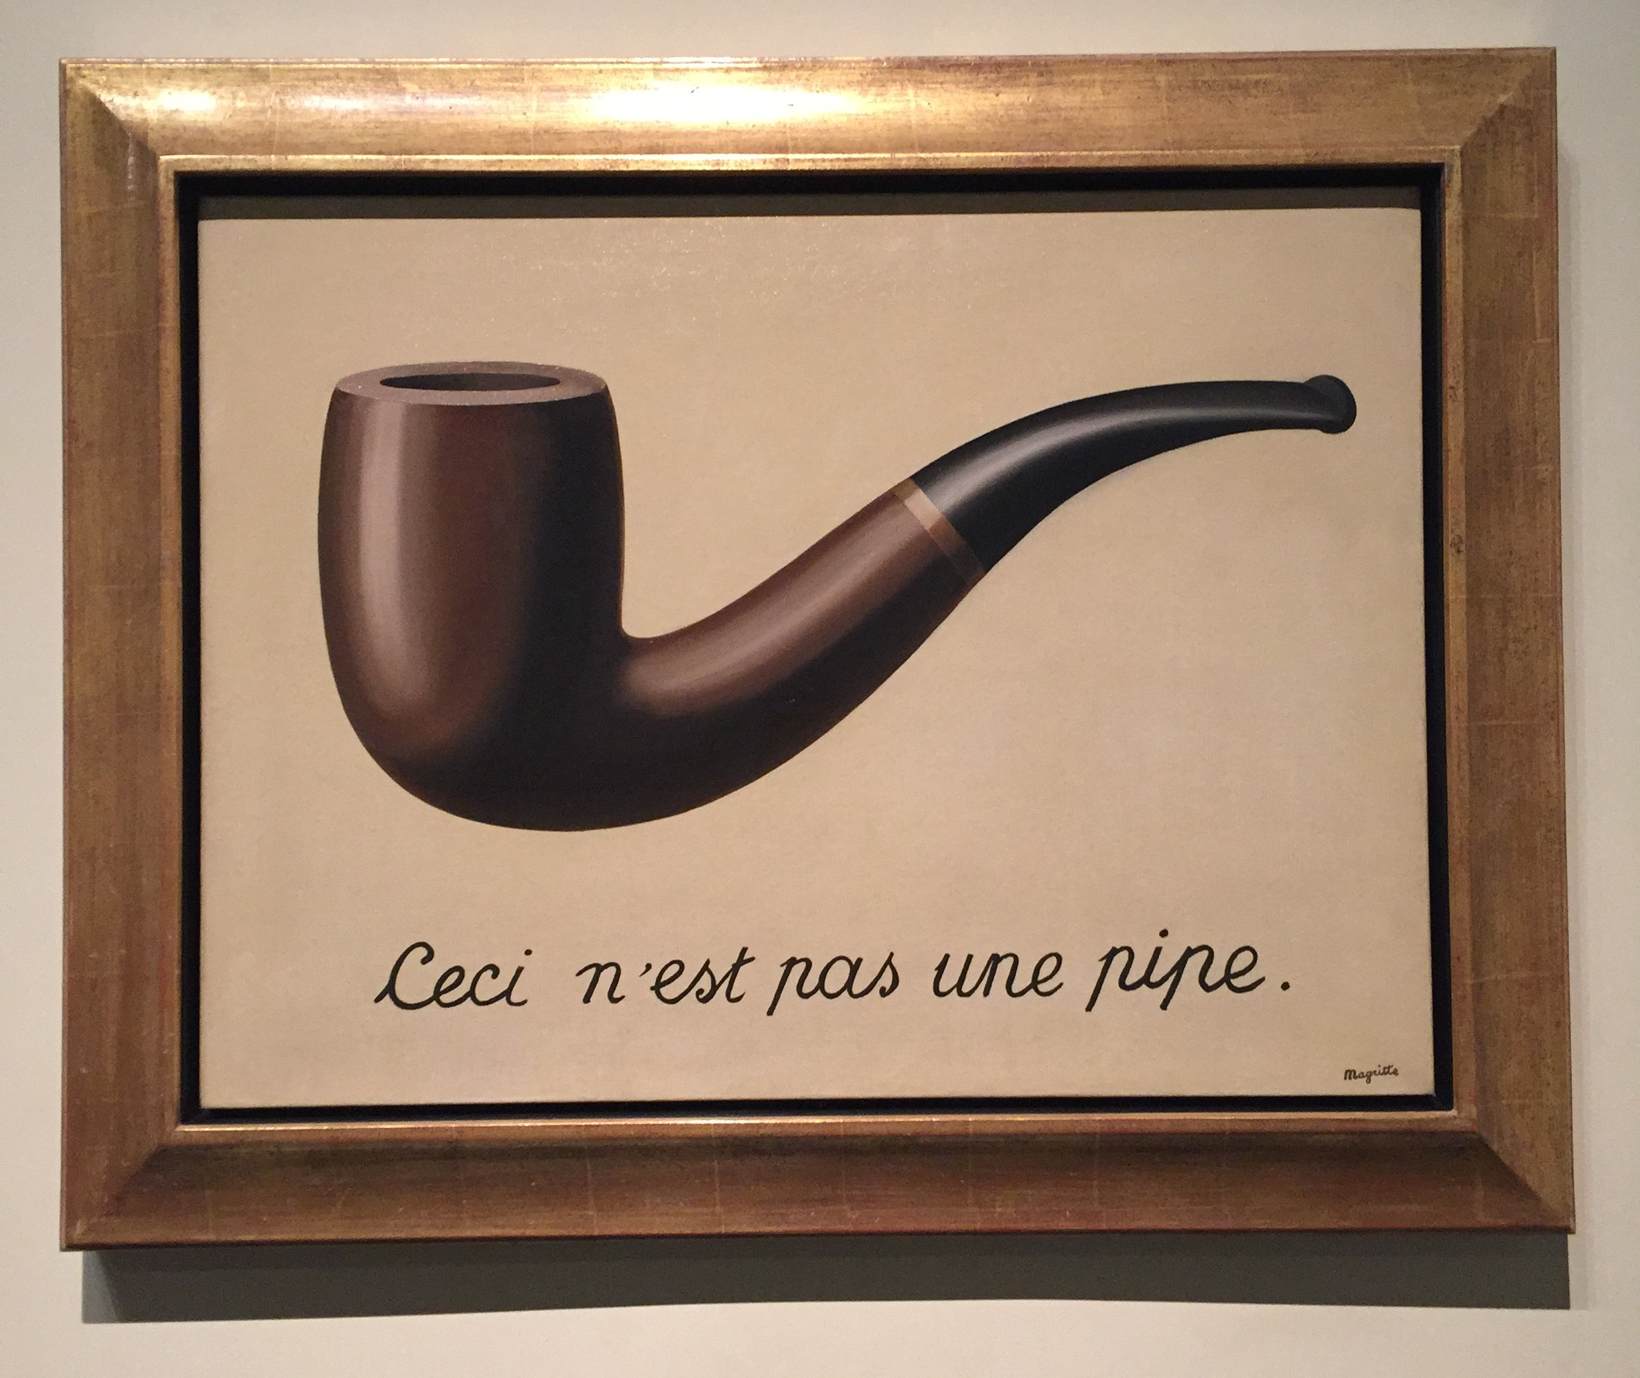
Learning from experience
Cat???
What is this?

Slide 46
Learning from experience
What even is that?
Once upon a
What comes next?

Slide 47
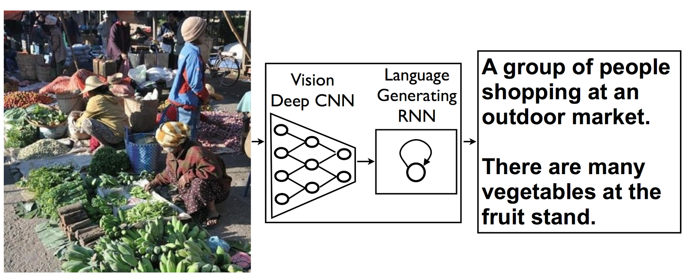
General intelligence
https://arxiv.org/pdf/1411.4555.pdf

Slide 48
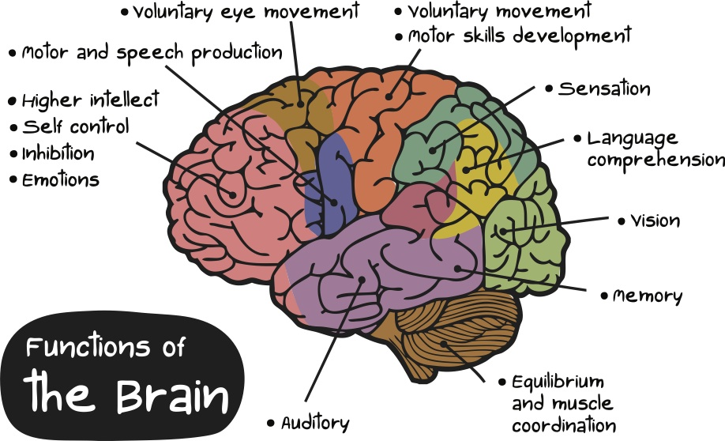
General intelligence

Slide 49
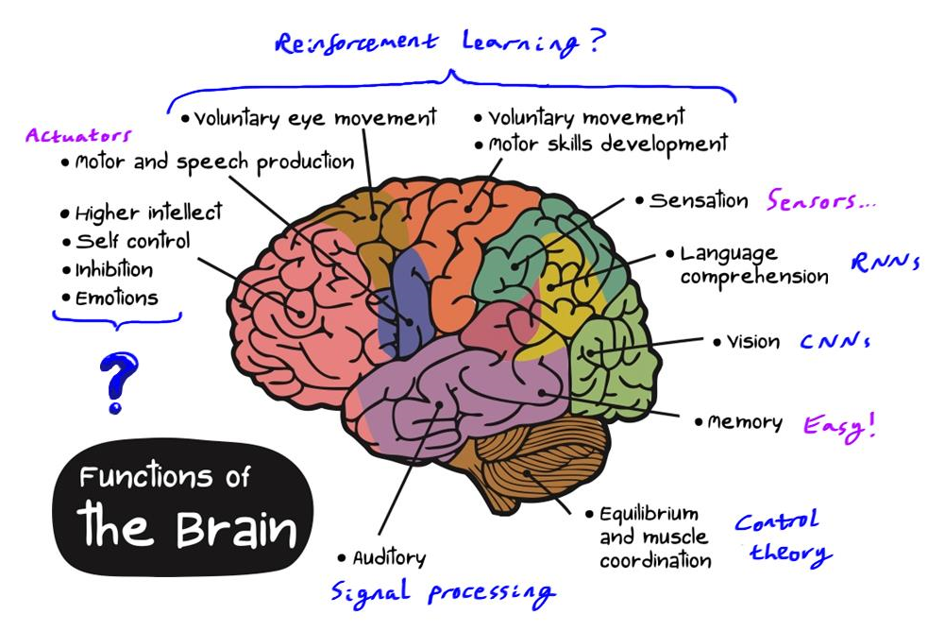

Slide 50
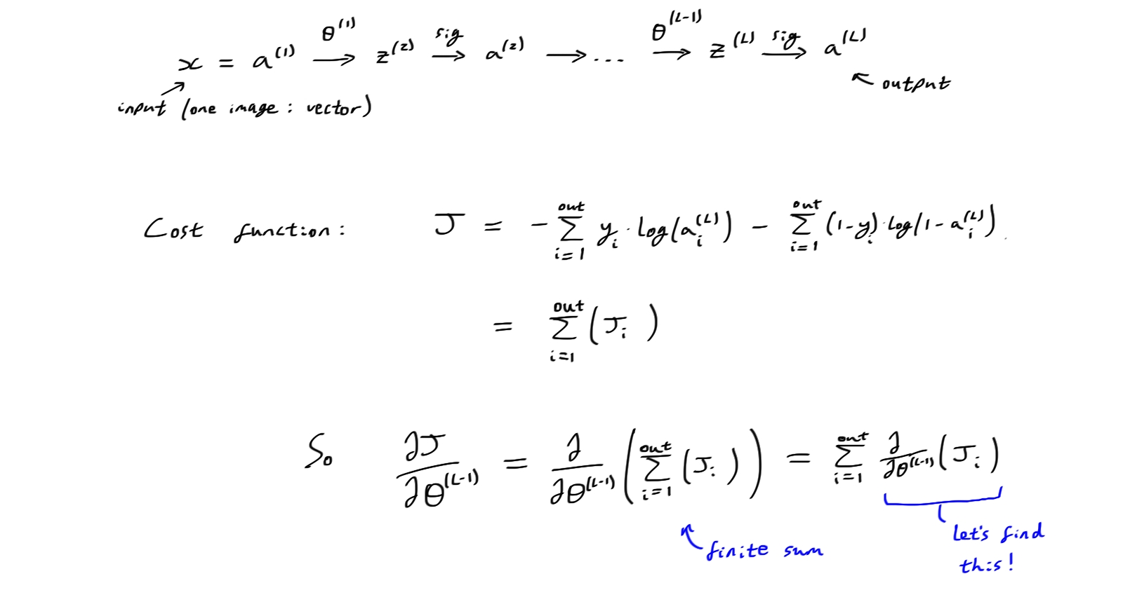
Backpropagation

Slide 51
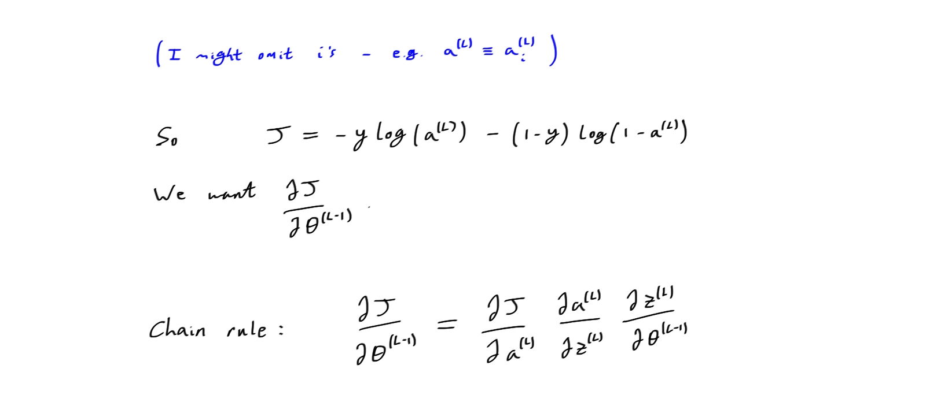
Backpropagation

Slide 52
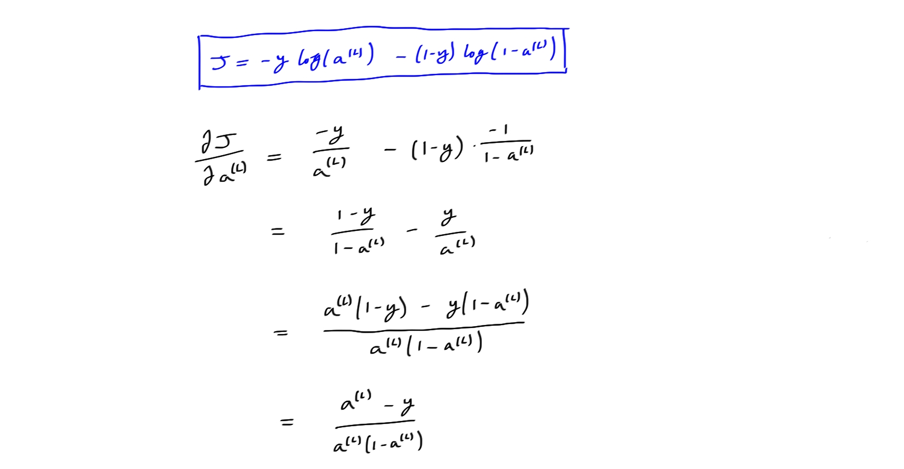
Backpropagation

Slide 53
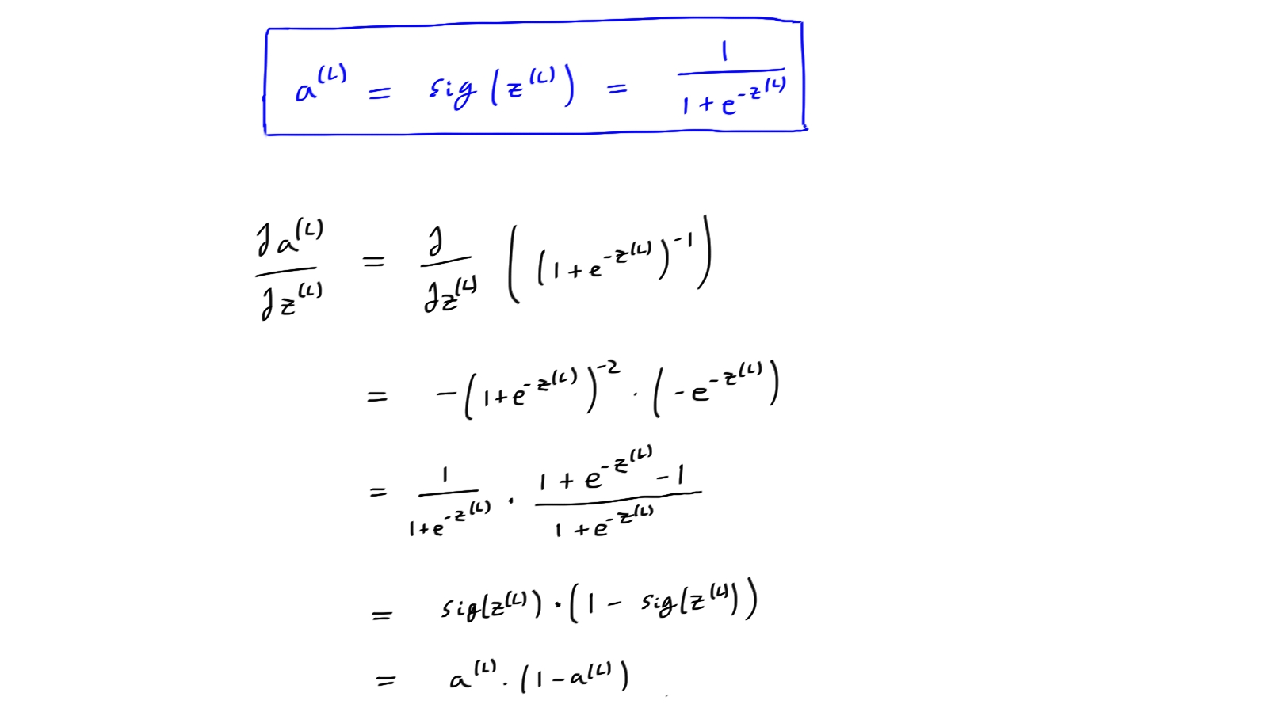
Backpropagation

Slide 54
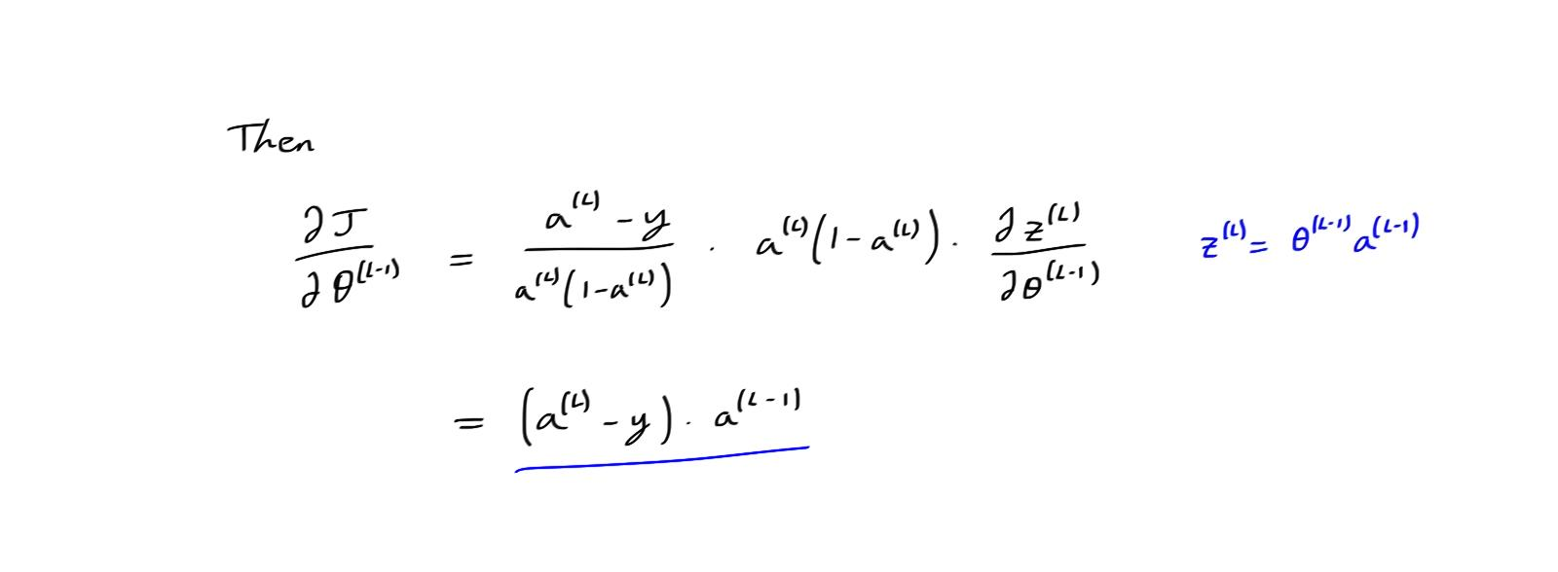
Backpropagation

Slide 55
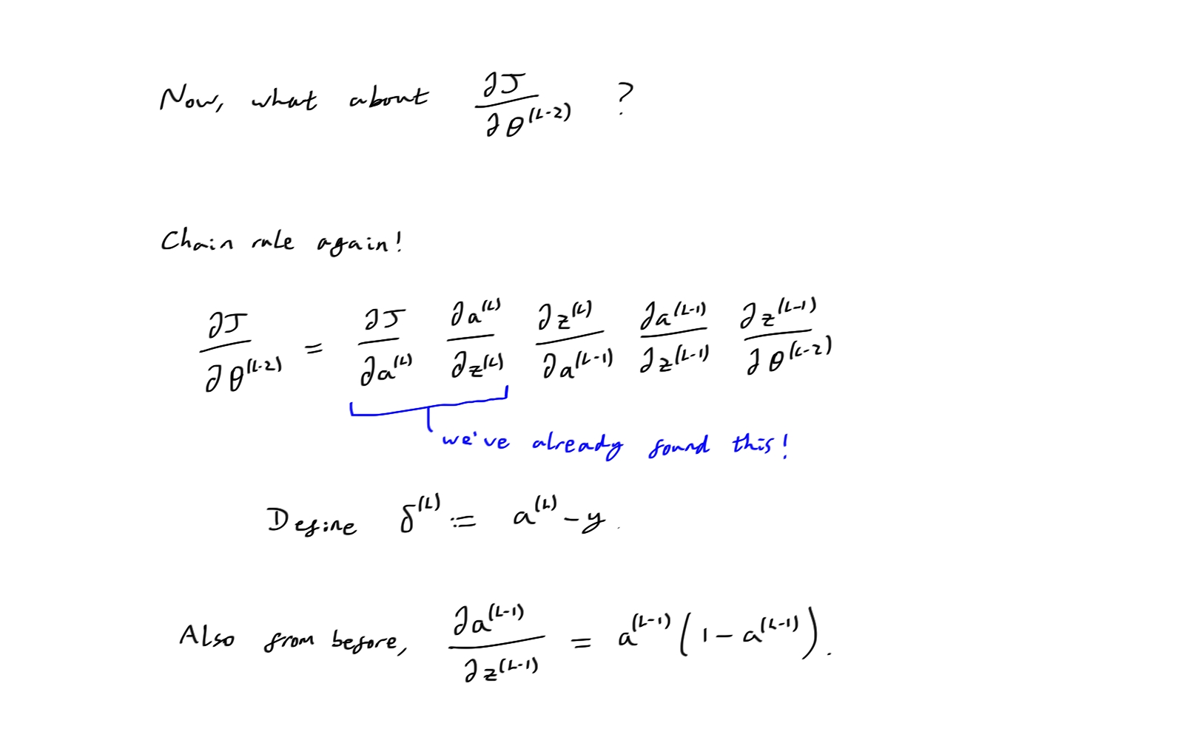
Backpropagation

Slide 56
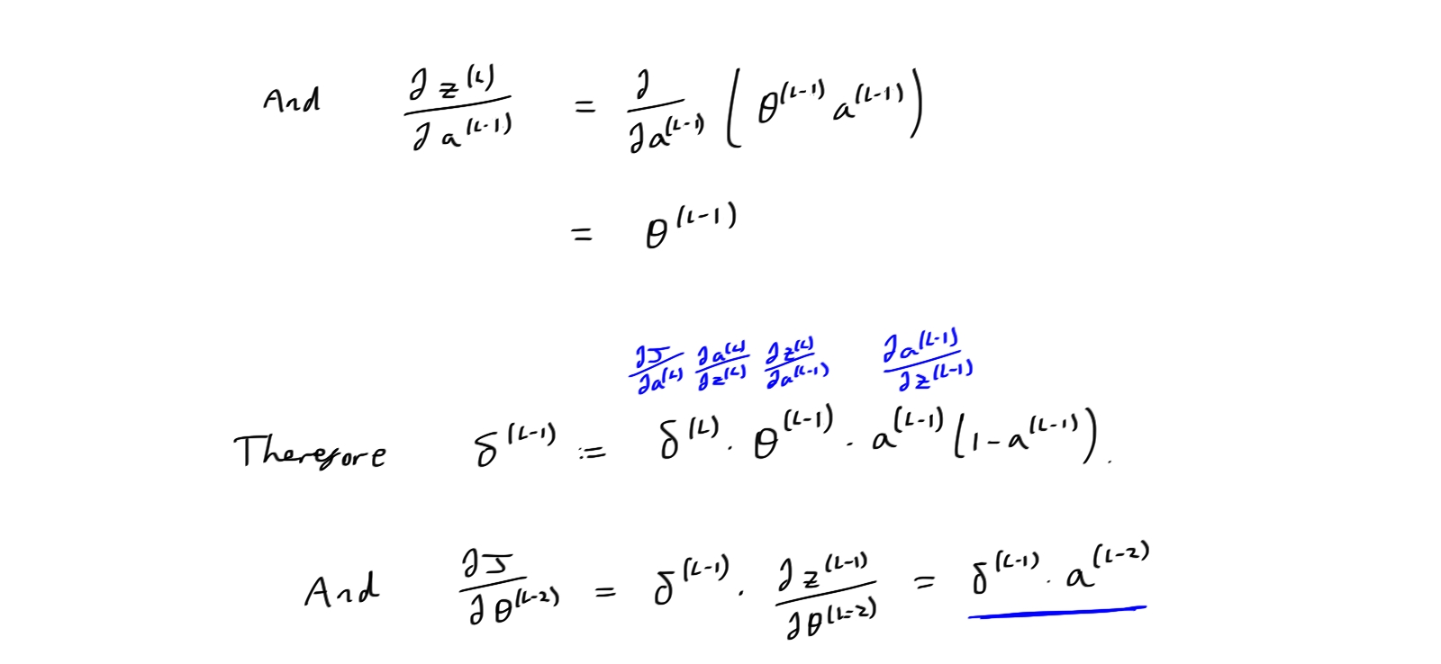
Backpropagation

Slide 57
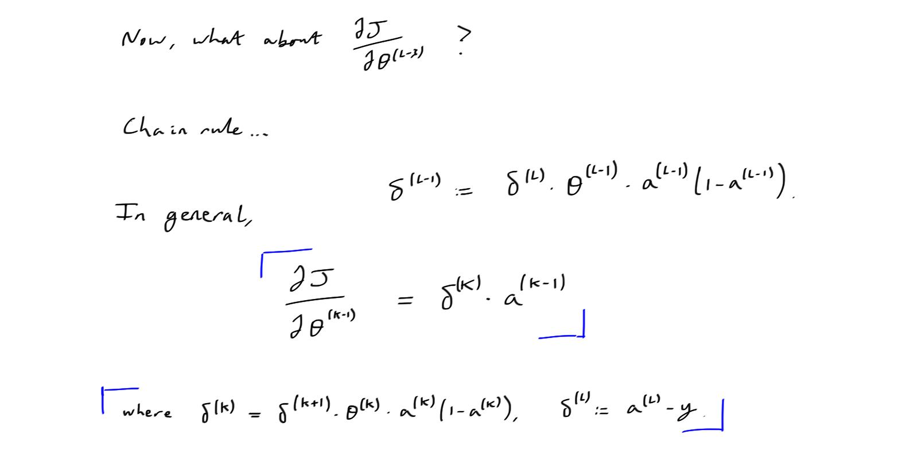
Backpropagation

Slide 58
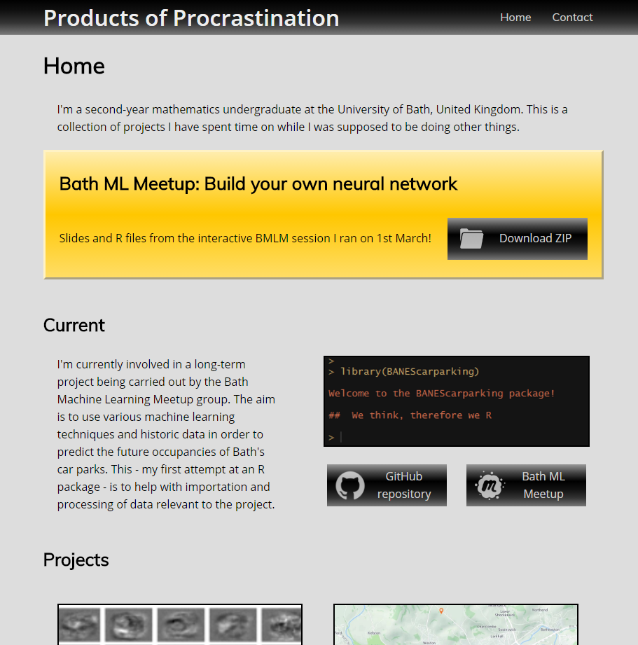
Contact me
https://uk.linkedin.com/in/owenjonesuob
Website: https://owenjonesuob.github.io
Email: olj23@bath.ac.uk
Twitter: @owenjonesuob
GitHub: https://github.com/owenjonesuob
LinkedIn: https://uk.linkedin.com/in/owenjonesuob

